Slide 1
Data-Logger
Local Network
Powered by Arduino

Slide 2
Overview
Based on Arduino, a broaden used Micro Controller, we developed a data-logger which is featured by its low cost, long battery life but outcoming flexibility to read nearly every kind of sensors, and finally, upload logs to the cloud.

Slide 3
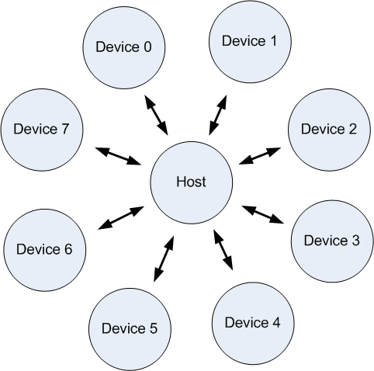
Overview: System topology
Generally, this system is star network topology, contributed by multiple logging nodes and coordinators.

Slide 4
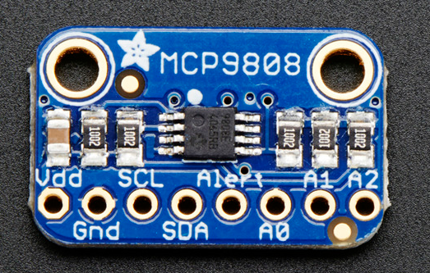
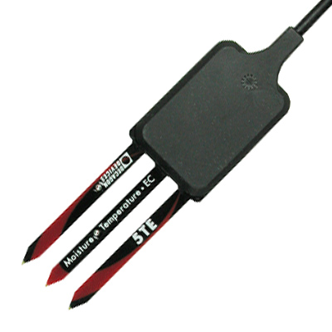
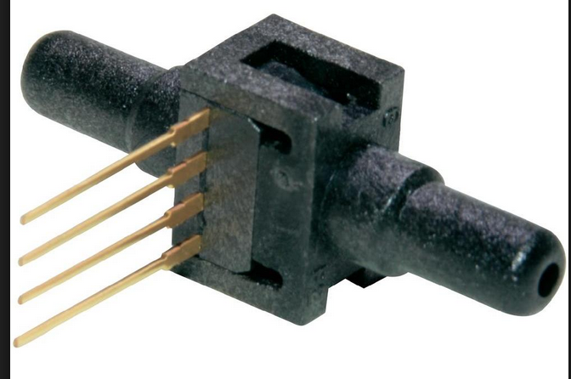
Feature: Flexible to different sensors
Arduino is designed for general usage, so our data-logger supports various of sensors, including temperature sensor, pressure sensor, moisture sensor, and more in the future.
MCP 9808 Temperature sensor
Decagon 5TE moisture sensor
Honeywell 26PCBFA6D Pressure Sensor

Slide 5
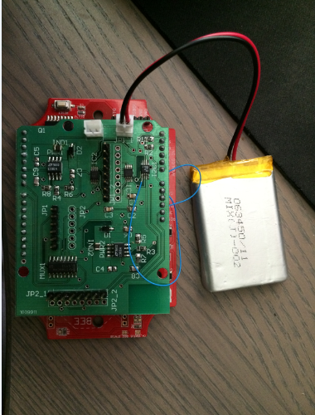
Feature: Long battery life
Each data-logging node is powered by Li-ion battery and connected to a solar panel. According to test in the campus, the node can be always on.

Slide 6
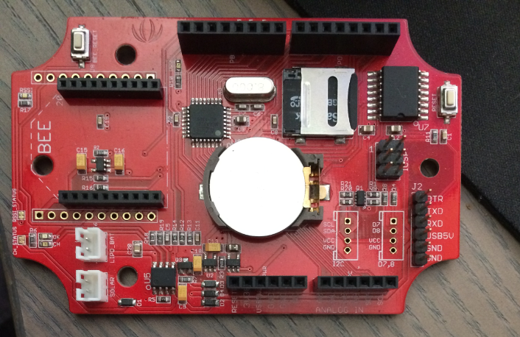
Feature: Store data in Safe way
Not Safe way but the safe way.
Every hour the data-logging node collect the data, it always store them in a micro SD card.

Slide 7
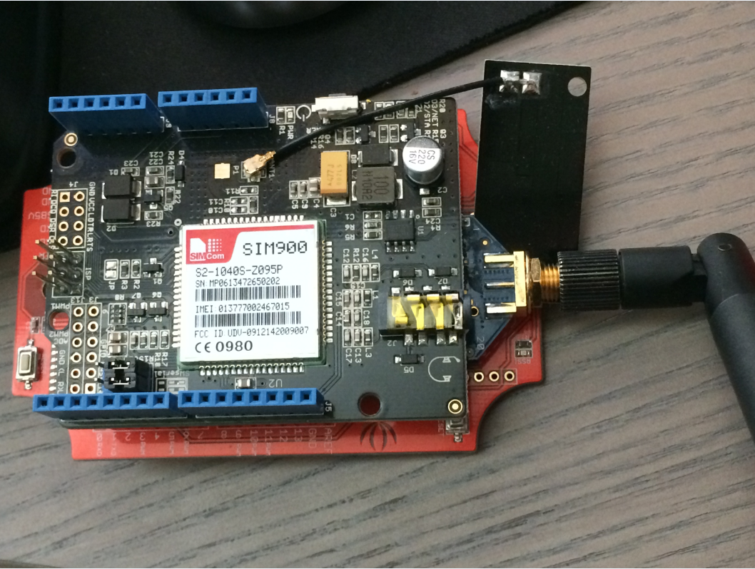
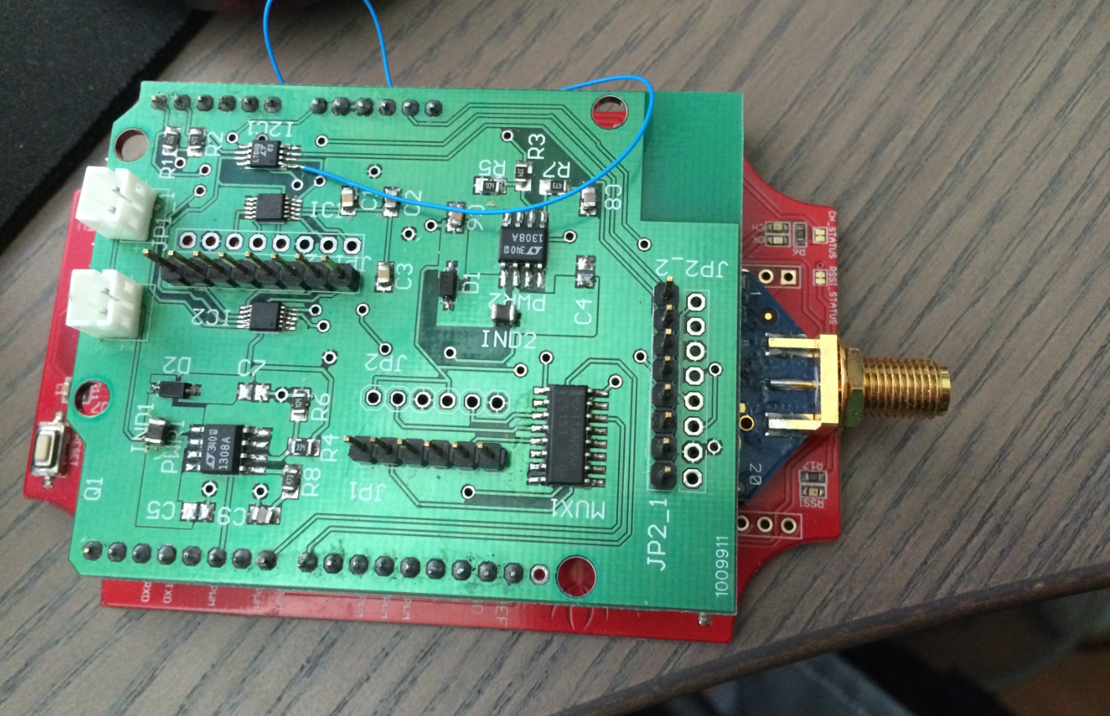
Feature: Local Network
Each data-logging node is not lonely, because multiple nodes and an coordinator can form a local network based on XBee, and coordinator also has GPRS board on it to collect logs from every node, upload them into cloud.
Coordinator.
Has XBee and GPRS board.
Data-logging node.
Has XBee and Sensor extension board.

Slide 8
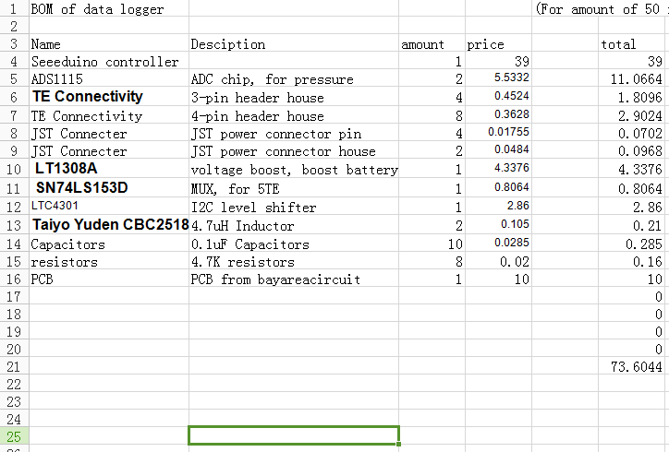
Feature: Low cost
The BOM (bill of material) of one data logging node only costs lower than $75
(Expensive sensors exclusive)

